Slide 1

Department of Computer Science and Engineering VIGNAN’S LARA INSTITUTE OF TECHNOLOGY AND SCIENCE Project Review on
Timetable Generator
Under The Esteemed Guidance of
Mr. T. V. Vamsi Krishna
Associate Professor
CSE Department
Presented By
Batch No:08
D.KALADHAR ROYAL 23FE1A6115 D.TEJASWINI 23FE1A6117
Y.NAGA SRUTHI 23FE1A6162
J.MANU 23FE1A6163
01/09/2025

Slide 2

TITLE
Timetable Generator
Department of Computer Science & Engineering
01/09/2025
2

Slide 3
CONTENTS
Title
Abstract
Introduction
Literature Survey
Existing System
Proposed System
Proposed Methodology
Conclusion
References

Slide 4
ABSTRACT
The process of creating academic timetables is a complex and time-consuming task. Manual scheduling often leads to errors, faculty conflicts, and overlapping classes. This project proposes an Automatic Timetable Generator System that provides role-based access for Admin, Faculty, and Students. The Admin has complete control over timetable creation, where faculty, section, and subjects are selected, and the timetable is generated automatically for multiple sections. The system stores the generated timetable in a database and makes it available for students and faculty to view . The proposed system ensures accuracy, reduces manual workload, and provides a user-friendly interface for managing academic timetables.

Slide 5
INTRODUCTION
Time management plays a crucial role in academic institutions, and timetables are at the core of organizing teaching and learning activities. Traditional timetable preparation is difficult, involving manual assignment of subjects, sections, and faculty members, often leading to conflicts. The increasing number of students and courses in higher education institutions makes the scheduling task more challenging.
This project introduces a web-based timetable generator system that simplifies the scheduling process. The system provides different dashboards for Students, Faculty, and Admins, ensuring proper access control. Admins can generate and store timetables automatically, while Students and Faculty can access their personalized schedules easily.
01/09/2025
Department of Computer Science & Engineering
5

Slide 6
LITERATURE SURVEY
S.No | Paper Title | Methodology | Drawbacks | Proposed Methodology to overcome those drawbacks
1. | Automated University Timetable Generation using Prediction Algorithm | Genetic Algorithm (GA):Works well For local optimization. Uses crossover & mutation to improve solutions iteratively. | It can’t generate multiple sections Timetable. | Over come the multiple sections Timetable.
01/09/2025
Department of Computer Science & Engineering
6

Slide 7
EXISTING SYSTEM
In most academic institutions, timetable preparation is still carried out manually or using basic tools like spreadsheets (Excel). The process typically involves department heads or administrators assigning subjects to faculty and scheduling classes for different sections.
Limitations of Existing Systems
Manual Scheduling
Preparation is time-consuming and requires significant effort.
High chance of errors such as overlapping classes, wrong faculty assignments, or empty slots.
No Automation
Any change (like a new subject, faculty substitution, or section adjustment) requires redoing the timetable manually.
Difficult to accommodate last-minute modifications.
Poor Accessibility
Students and faculty usually receive timetables in printed form or static PDFs.
Updates are not instantly reflected, leading to miscommunication.
Limited Role-Based Access
Existing systems often do not distinguish between Admin, Faculty, and Student roles.
No personalized dashboard for different users.

Slide 8
PROPOSED SYSTEM
The proposed system is a role-based automatic timetable generator:
Admin:
Controls the system.
Selects faculty, subject, and section.
Generates timetable automatically.
Stores timetable in a database.
Faculty:
Views personal teaching timetable.
Downloads schedules for reference.
Student:
Views their class timetable (section-wise/day-wise).
Downloads schedule for offline use.

Slide 9
PROPOSED SYSTEM
Key Features:
Automatic timetable generation.
Role-based access (Admin, Faculty, Student).
Database storage for quick retrieval.
Downloadable schedules.

Slide 10
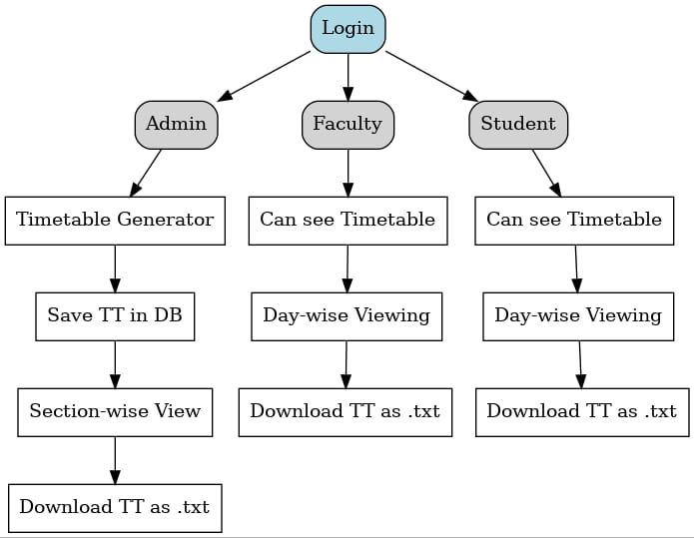
PROPOSED METHODOLOGY

Slide 11
CONCLUSION
The Automatic Timetable Generator reduces manual workload and minimizes scheduling errors in academic institutions. By providing role-based dashboards, it ensures that Admins manage timetables effectively, while Faculty and Students can easily access their respective schedules. The system is scalable, reliable, and can be extended to include features like real-time notifications, exam timetables, and mobile application support in the future.
01/09/2025
Department of Computer Science & Engineering
11

Slide 12
REFERENCES
Wong, T. et al. (2019). Automated Timetable Generation Using Constraint Satisfaction and Genetic Algorithms. Journal of Computer Applications.
Abdullah, S., & Turabieh, H. (2012). Generating university course timetable using genetic algorithms and local search. Proceedings of the International Conference on Computer Science.
Kumar, R., & Singh, V. (2018). Web-based timetable management system for universities. International Journal of Computer Applications, 181(3).
01/09/2025
Department of Computer Science & Engineering
12

Slide 13
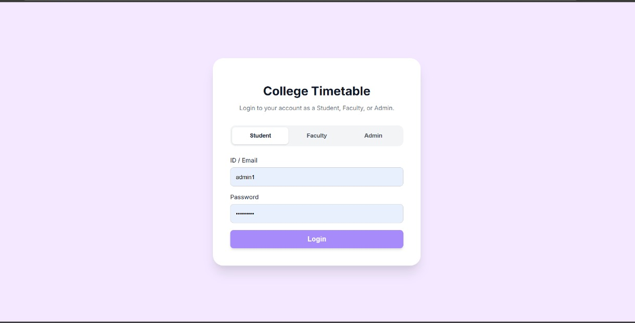
Result : Login page

Slide 14
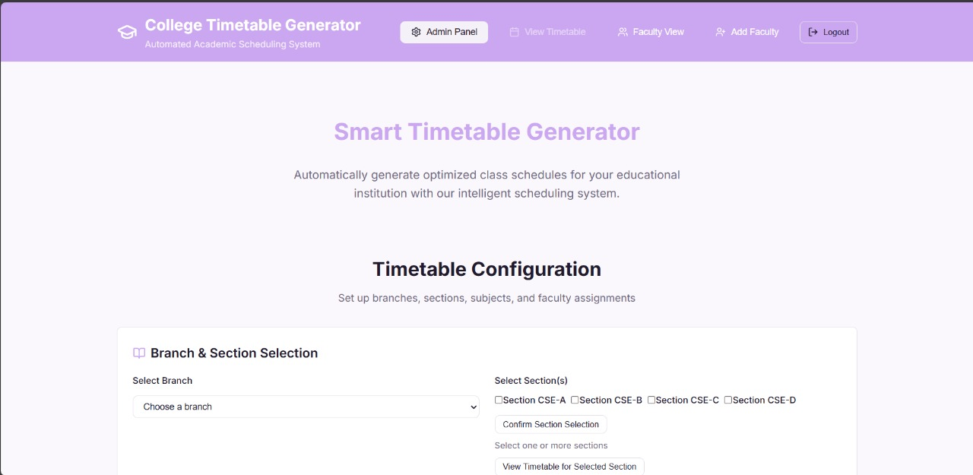
Admin page

Slide 15
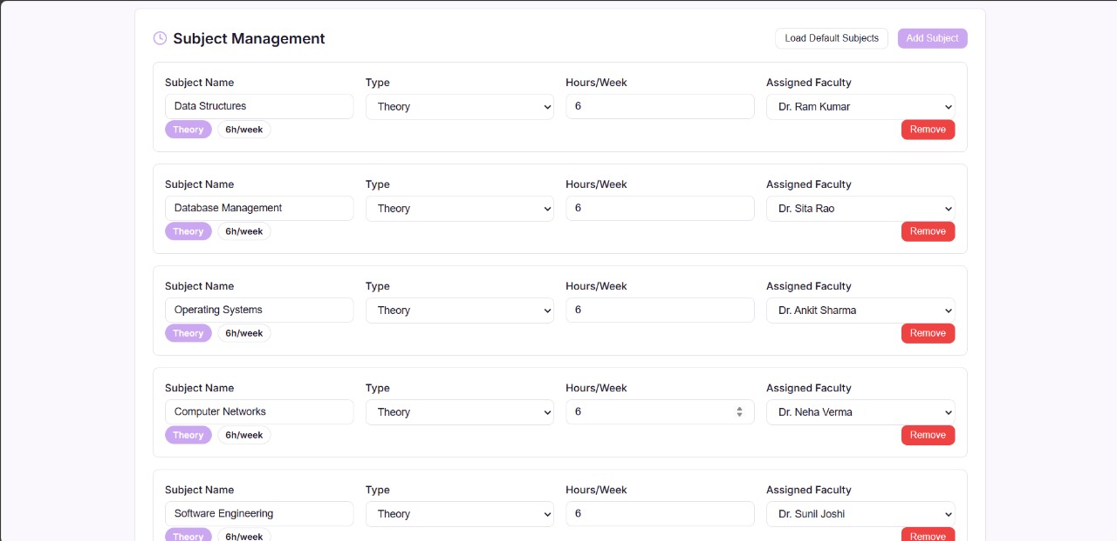

Slide 16
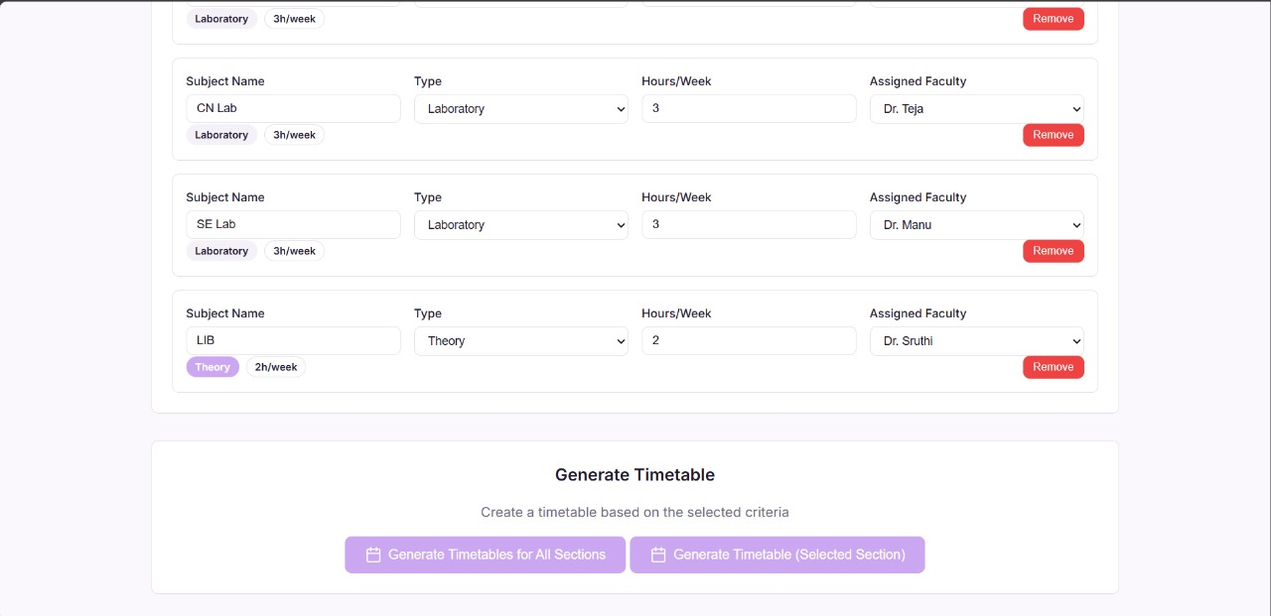

Slide 17
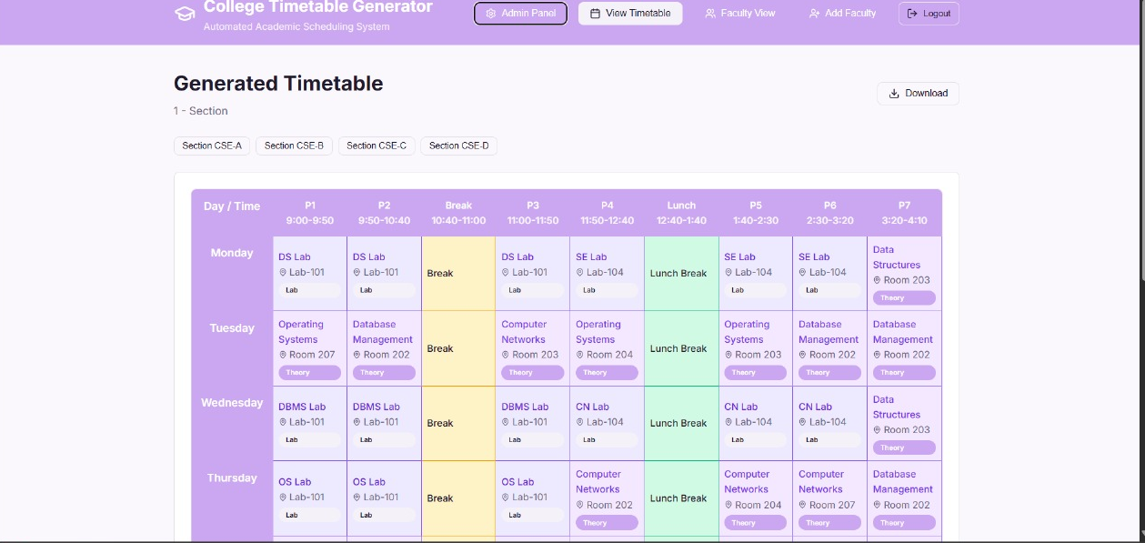

Slide 18
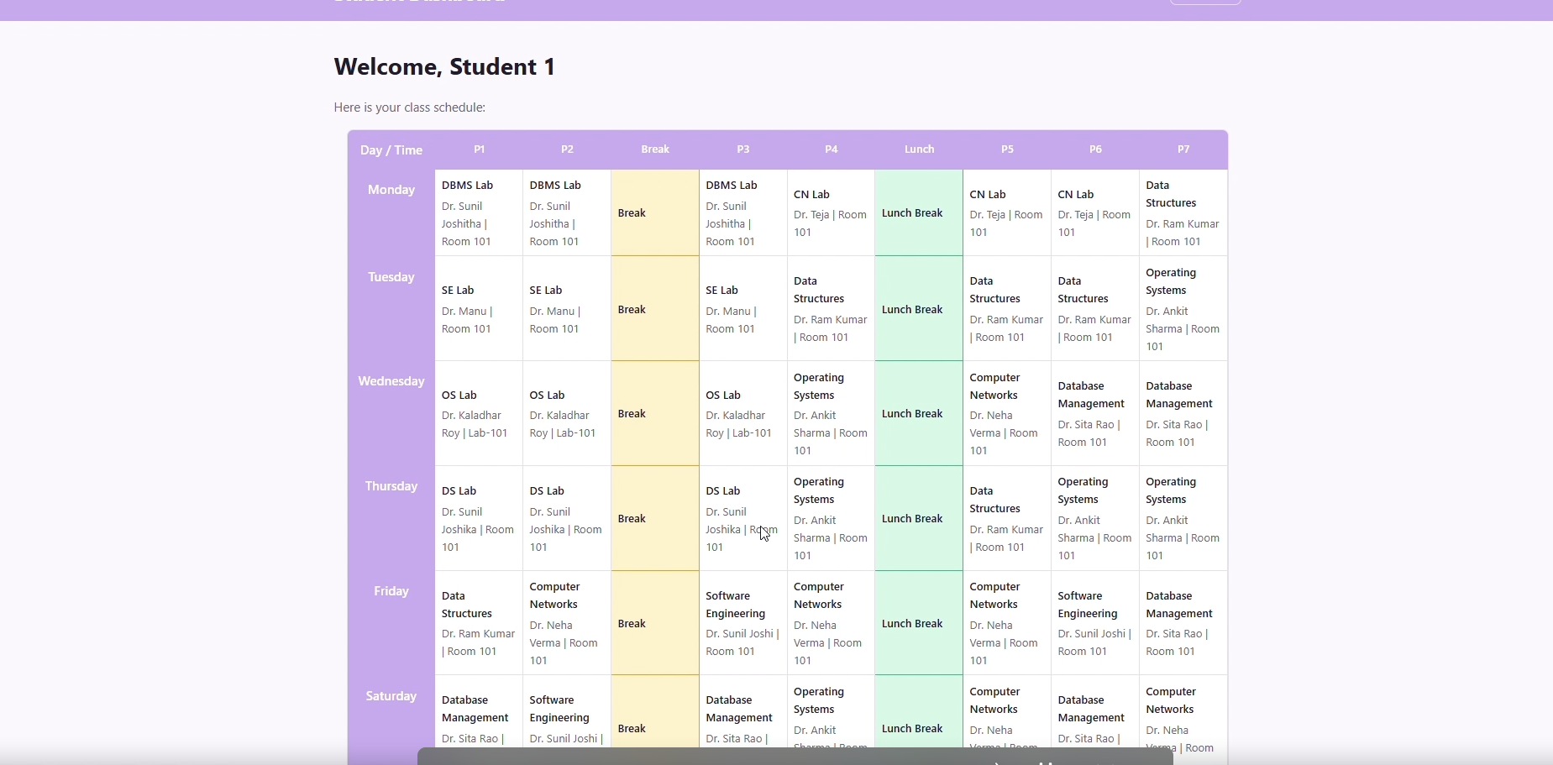
Student Login page

Slide 19
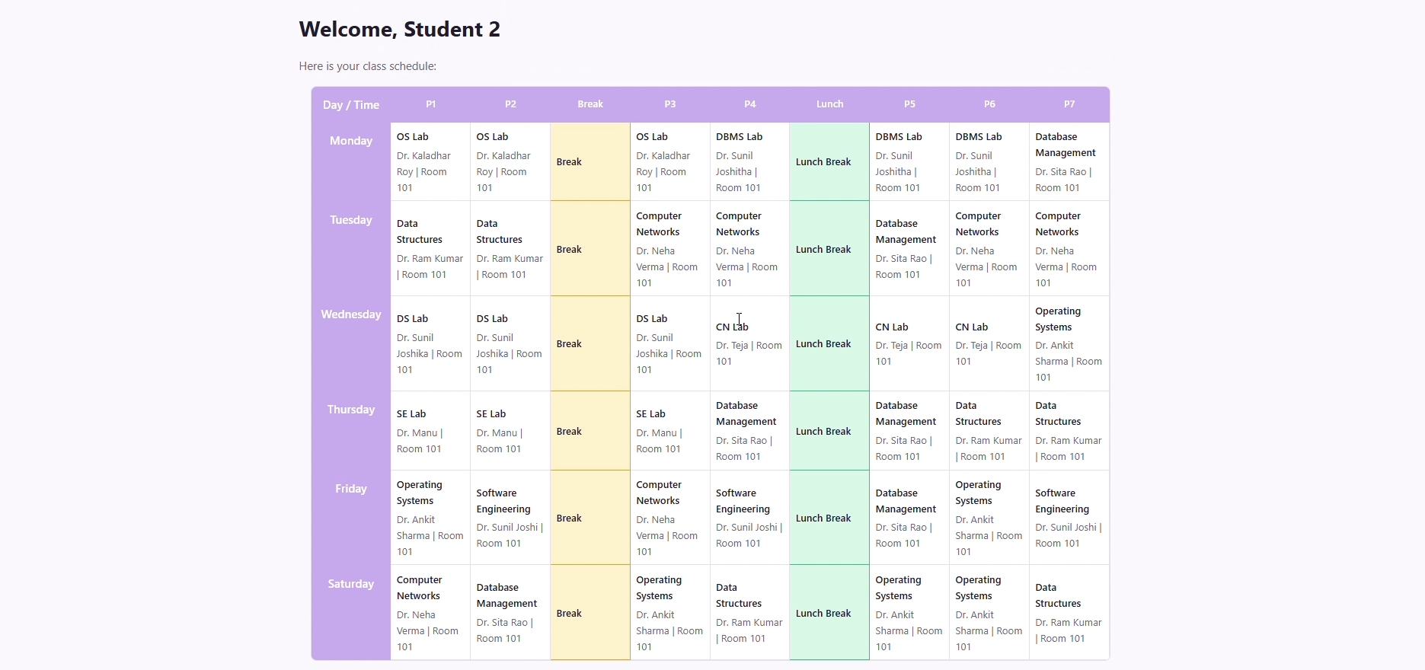

Slide 20
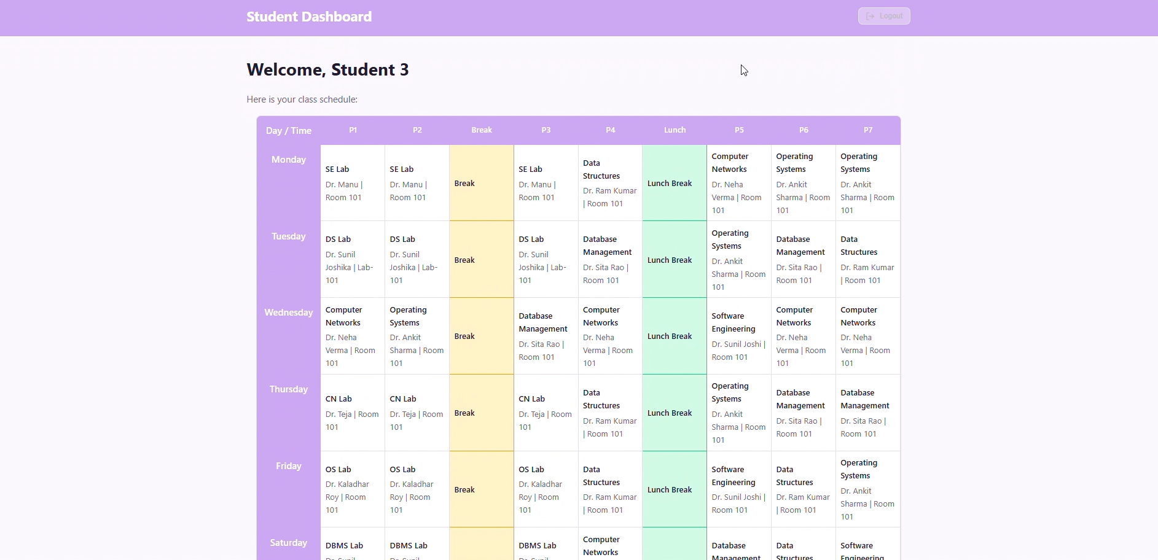

Slide 21
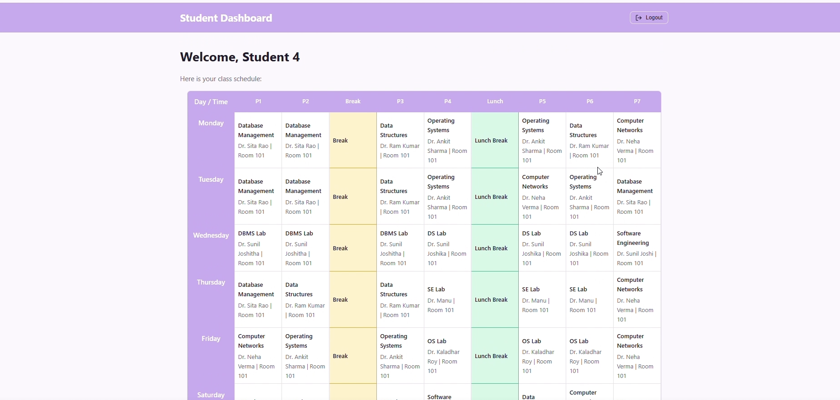

Slide 22
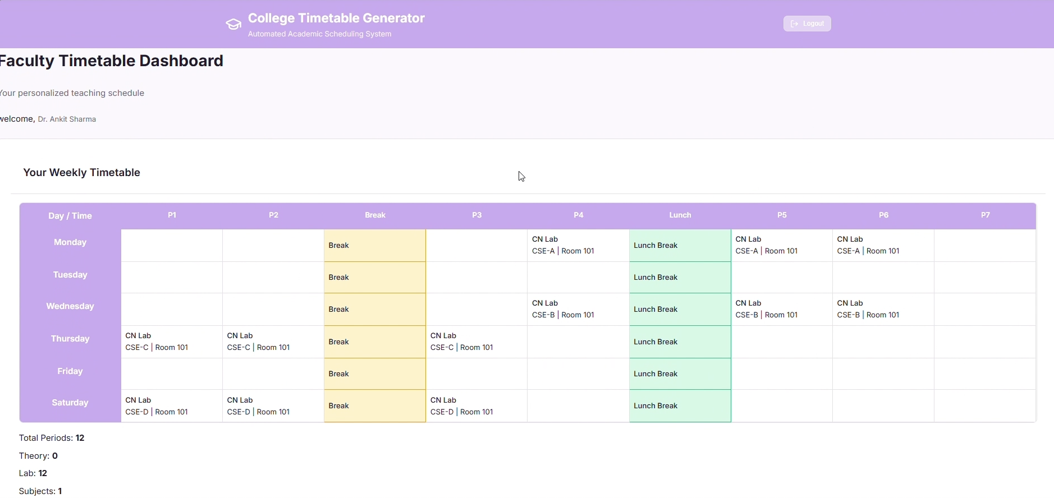
Faculty Login

Slide 23
Thank You

